Slide 1
TANFINET Hackathon Problem 3- Predictive Surveillance of Optical Fibre Routes
Smart Risk-Based Fiber Surveillance Using GIS, Edge AI, Selective Piezo Sensing & LoRa
Team Interference
Gouri Manocha RA2311004010355
Navya Jain RA2311004010307
Aravindhan Balamurugan RA2311004010348
T Ahil Adithyaa RA2311004010222

Slide 2
Abstract
Optical fiber routes powering India’s telecom backbone are damaged daily by digging, construction, and accidental interference. Current systems detect failures AFTER the break occurs, causing costly outages. Full solutions like industrial DAS cost Rs25,00,000+ and are not viable for low-budget deployments.
It uses GIS + AI to first identify high-risk zones on the fiber route, then deploys low-cost piezo/MEMS vibration sensors ONLY at those critical points, connects them via a LoRa mesh network, and visualizes all threats on a live GIS dashboard in real time.
This hybrid approach reduces hardware deployment by 70-90% versus full-route monitoring, brings total PoC cost under Rs.5000, and is fully buildable using off-the-shelf components — while remaining technically credible and scalable to real-world telecom networks.

Slide 3
Problem Statement
The Real-World Problem
28% of all fiber outages are caused by third-party damage from digging, unauthorized construction, and accidental interference. Each major cut costs telecom operators Rs. 20-25 lakh in downtime and emergency repairs. India’s BharatNet alone spans 600,000 km of rural fiber — largely unmonitored.
Why Current Solutions Don’t Work:
OTDR alarms fire ONLY after the cable is broken — damage is already done. Full DAS systems cost Rs. 25-80 lakh per unit — unaffordable for most operators. Full-fiber piezo coating is impractical: a 100 km route would require millions of sensors. There is no proactive, affordable system that detects threats before contact.
The Gap We Are Solving:
No affordable, deployable system exists today that:
(1) predicts WHERE on a route damage is most likely, (2) places sensors intelligently only at those spots, and (3) connects and alerts field teams in real time — all at a cost that is actually practical for telecom operators in developing markets.

Slide 4
Proposed Solution
Layer 0 (Free) — Government Data Intelligence:
Pull municipal excavation permits, smart city APIs, and road development plans. If construction is approved near the fiber route, an automatic alert is generated before a single sensor detects anything. Cost = software only. This eliminates the majority of planned-dig threats at zero hardware cost.
Layer 1 — GIS + AI Risk Zone Engine:
GIS maps the entire fiber route. An AI model overlays historical damage data, construction density, soil type, road crossings, metro proximity, and railway crossings to generate a Risk Heat Map. Only the top 10-30% highest-risk zones are flagged for physical sensor deployment — reducing hardware by 70-90%.
Layer 2 — Selective Piezo/MEMS Sensor Nodes :
Low-cost piezo buzzer discs (Rs. 10-30 each) or MEMS accelerometers (MPU6050, Rs. 50-80) are embedded in waterproof casings and buried at GIS-identified high-risk points only. Each node runs a sleep-mode microcontroller that wakes ONLY on vibration threshold breach, giving 1-2 years battery life per node.
Layer 3 — LoRa Mesh Network :
Sensor nodes transmit via LoRa (long range, ultra low power) to a gateway every 2-5 km. No SIM card, no GSM cost, no data plan needed. Multiple sensors share one gateway. Range up to 5-10 km in open terrain and 500m-1km in buried . This alone cuts communication costs by 80% versus GSM-per-sensor models.
Layer 4 — GIS Dashboard :
Gateway sends data to a Laptop/Fast running API edge processor running a CNN-LSTM model that classifies threat type: excavator, drill, heavy vehicle, or footstep. Classified events geo-tagged and plotted live on GIS dashboard. Tiered alerts fire: Level 1 = log, Level 2 = NOC SMS, Level 3 = field crew GPS dispatch with one-tap navigation.

Slide 5
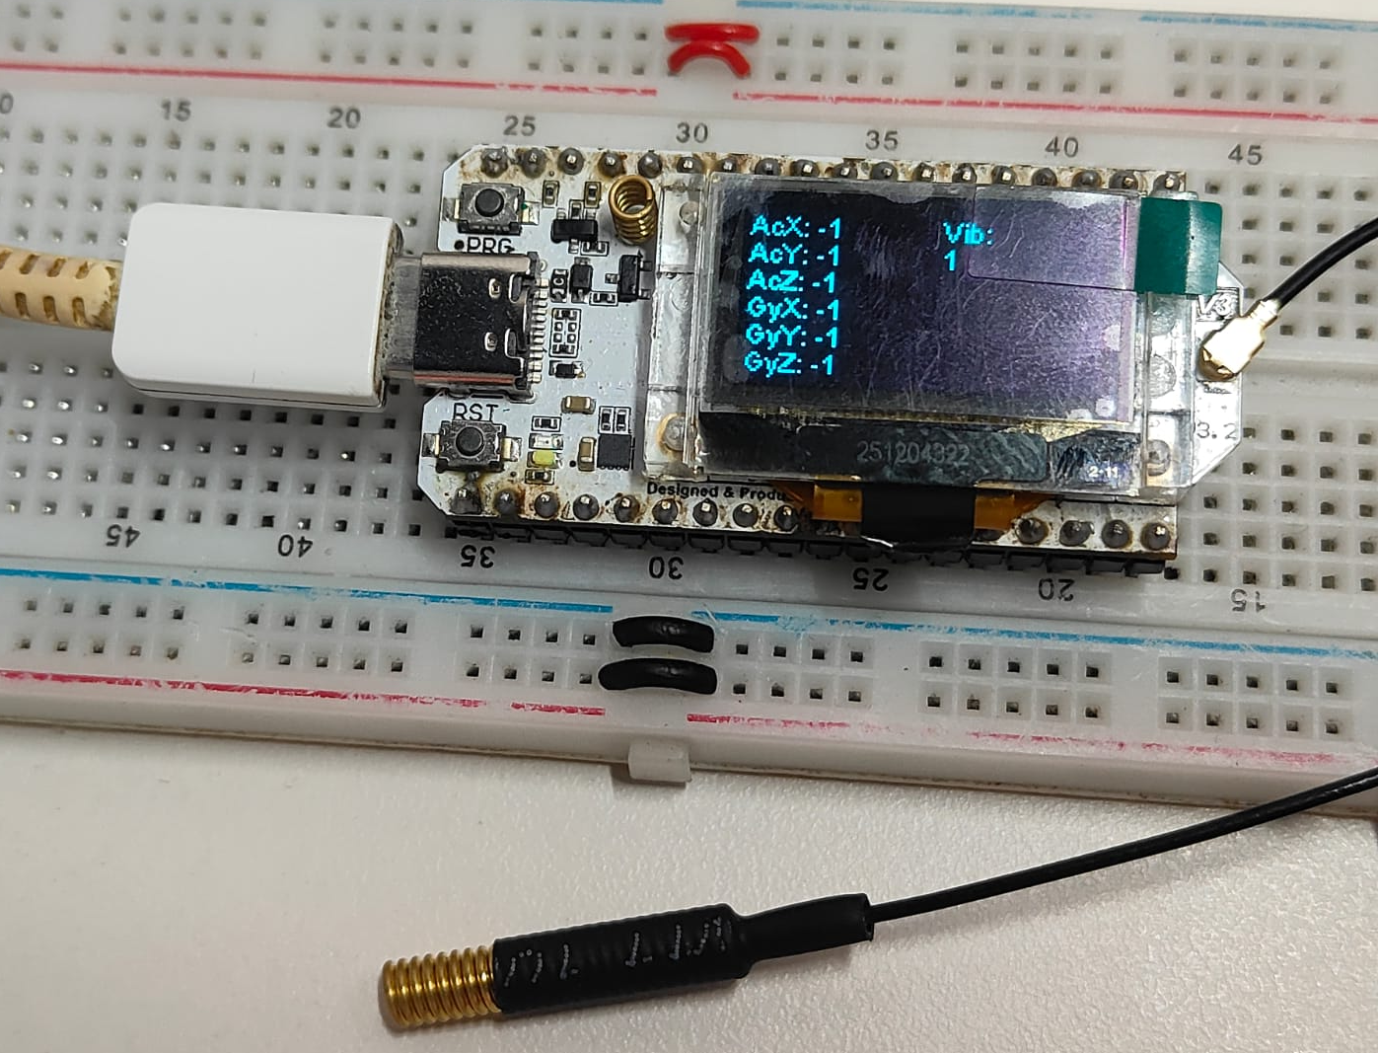
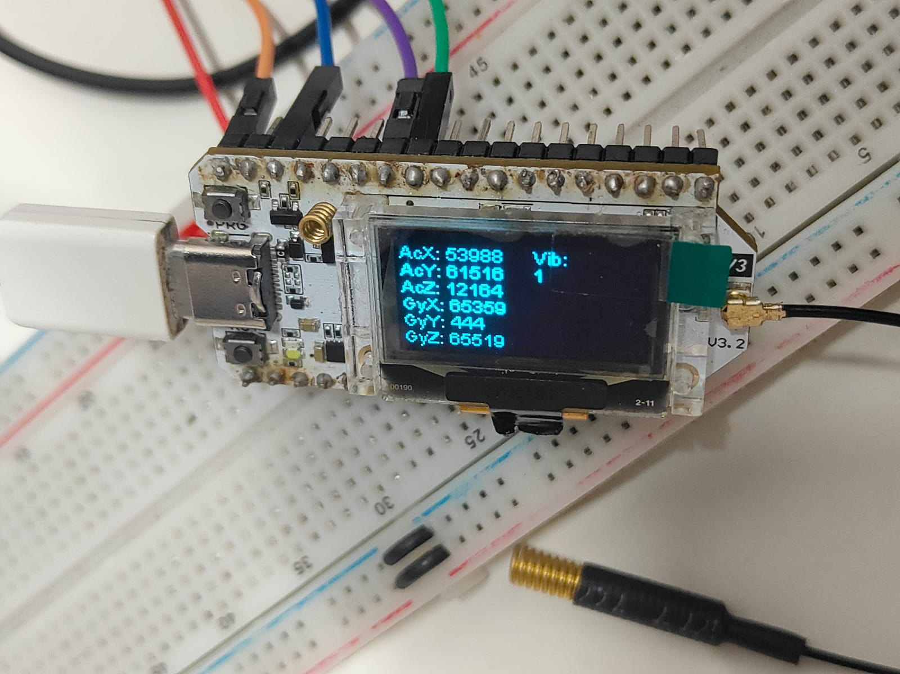
Proof of Concept
Total PoC Hardware Cost: Under Rs. 5,000
Hardware Setup:
3 sensor nodes: piezo buzzer disc (Rs. 20) + MPU6050 MEMS accelerometer :1 Hz – 1000 Hz (Rs. 60) + STM 32 Blue pill (Rs. 150) + waterproof IP67 casing (Rs. 80) ,LoRa Gateway: Heltec Wifi LoRa 32 :2.4Ghz(Rs. 1500). Total Poc = Rs.4,130. Node draws ~12µA in deep sleep; wakes to active in <5ms on piezo interrupt.
AI Model — What We are going to Built:
CNN-LSTM model trained on 6 vibration classes: tap (simulates digging), drill simulation, vehicle vibration, footsteps, cable theft (sudden tension + cut pattern), baseline silence. Dataset: public seismic/acoustic datasets + lab-recorded events on a sand tray over buried sensor. Model quantized with TensorFlow Lite. Inference on STM32 Blue Pill + Heltec LoRa V3 receiver (data forwarded to PC via WiFi): under 50ms.
GIS Risk Map Demo:
QGIS used to map a sample 2 km fiber route in our campus area. Historical road-digging records and construction zones overlaid as risk layers. AI model outputs a risk heatmap — 3 high-risk zones identified. Sensor nodes placed only at those 3 points in our physical demo.
Live Dashboard Demo:
React + Leaflet dashboard shows fiber route on real map. When a node detects a threat, a color-coded pin drops on the exact GPS location in real time via WebSocket. Threat type, confidence score, timestamp, and nearest access route shown. Alert pushed simultaneously to a simulated mobile view. Full stack: Python + FastAPI + PostgreSQL/PostGIS + React.
Transmission through LoRa

Slide 6
MVP Features
Feature 1 — GIS Risk Heat Map Generator
AI model overlays construction data, road crossings, railway/metro zones, and historical incidents to rank every segment of the fiber route by damage probability. Outputs a visual heat map. Operators deploy sensors only in red zones, saving 70-90% on hardware.
Feature 2 — Government Permit Alert (Zero Hardware Layer)
API integration with municipal excavation permit systems. When any dig permit is approved within 100m of the fiber route, an automatic alert is generated before physical work begins. This is the cheapest possible threat prevention — purely software, no sensors required.
Feature 3 — Sleep-Mode Sensor Nodes (Rs. 1110/node)
Piezo disc + MPU6050 MEMS sensor encapsulated in waterproof IP67 casing. Microcontroller stays in deep sleep until vibration crosses threshold. Wakes, classifies via onboard Edge AI, and transmits via LoRa only when a real event is detected. Detects: excavator, drilling, heavy vehicle, footstep, and cable theft (sudden tension + cut signature). Battery life: 1-2 years per node.
Feature 4 — LoRa Mesh Network (No SIM Cost)
All sensor nodes connect to shared LoRa gateways (one per 2-5 km). No SIM, no data plan, no monthly telecom cost. Range up to 15 km in open areas. Reduces communication cost by 80% versus a GSM-per-node model. Ideal for rural and semi-urban BharatNet routes.
Feature 5 — Live GIS Dashboard + Tiered Dispatch
Real-time threat pins on interactive map with severity color coding (green/orange/red). Level 1 = auto-log. Level 2 = SMS to NOC. Level 3 = GPS-guided field crew dispatch with one-tap navigation. Historical heatmap identifies recurring risk zones for future sensor redeployment decisions.
Feature 6 — Crowd-Sourced Validation Loop
Field engineers confirm or dismiss alerts via mobile app. Each confirmed event re-trains the AI model, improving accuracy over time. False positive rate reduces progressively — the system gets smarter with every deployment month.

Slide 7
Conclusion and Future Scope
Why our solution Wins on Every Dimension
Cost: Full DAS = Rs. 25-80 lakh. Full piezo coating = impractical. PoC = Rs. 5,000. Production deployment per km = Rs. 8,000-12,000 (vs. Rs. 80,000+ for industrial alternatives). Scalability: LoRa + selective deployment scales from 5 km pilot to 600,000 km national network. Technical depth: 4-layer architecture covering AI, IoT, GIS, and networking.
Comparison Table: Method vs. Cost vs. Scalability vs. Practicality
Full piezo coating: Very High cost , Hard to scale ,Not practical. Full DAS system: Very High cost , Good scale ,Used only in oil/gas. Selective piezo nodes ( Layer 2): Medium cost , Good scale , Practical. GIS predictive model ( Layer 1): Low cost , Excellent scale , Very scalable. Government permit integration ( Layer 0): Zero hardware cost , National scale , Immediately deployable.
Real-World Alignment
Directly applicable to BharatNet rural fiber (600,000+ km). Aligns with EU Cable Security Action Plan 2025 which allocated significant funding Rs. 5,500 crore for monitoring technology. Replicable in Southeast Asia and Africa where telecom operators face identical cost constraints.
Phase 2 Roadmap
Integrate satellite imagery at flagged coordinates for visual threat confirmation. Add federated learning across operators — models improve without sharing raw data. Add geophone sensors for deeper underground vibration detection. Pilot with a real telecom operator on a 5 km stretch. Explore integration with TRAI’s national fiber monitoring initiative.
The Right Solution at the Right Cost — Smart, Not Expensive.

